Slide 1
Parcel Transport Monitor
34346 Networking technologies and application development for Internet of Things (Spring 2023)
Group 3
Erik Gottschalk, Juan Marin Collado, Sindhuja Ramamoorthy, Gustav Juul Jørgensen, Rudolf Anton Fortes

Slide 2
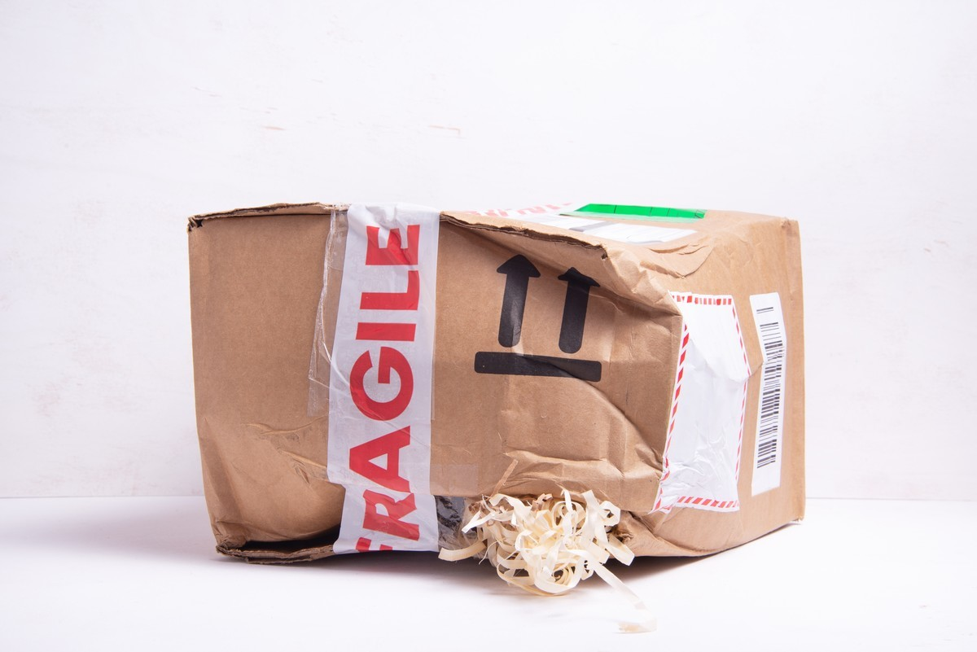
Notes:
We all have had bad experiences when ordering online. Items lost, bended, damaged or even broken. This is a real problem and unfortunately also for big companies when they order expensive equipment or items with special requirements.
We aimed to help shipping companies keep track and monitor sensitive items while they are being shipped. For example shipping:
Paintings
Fresh food
Plants
Animals
Fragile objects (glass, ceramics, precise instrumentation)
Liquids (if tilted they can leak)
This way they can quickly get notified if something is not going as supposed in the process and take actions before is to late. Furthermore, if the damage is not reversible, companies can trace back where and what happened so they can find the cause or the responsible. To achieve this we use different sensors and modules to communicate with a backend that will be explained later by Erik

Slide 3
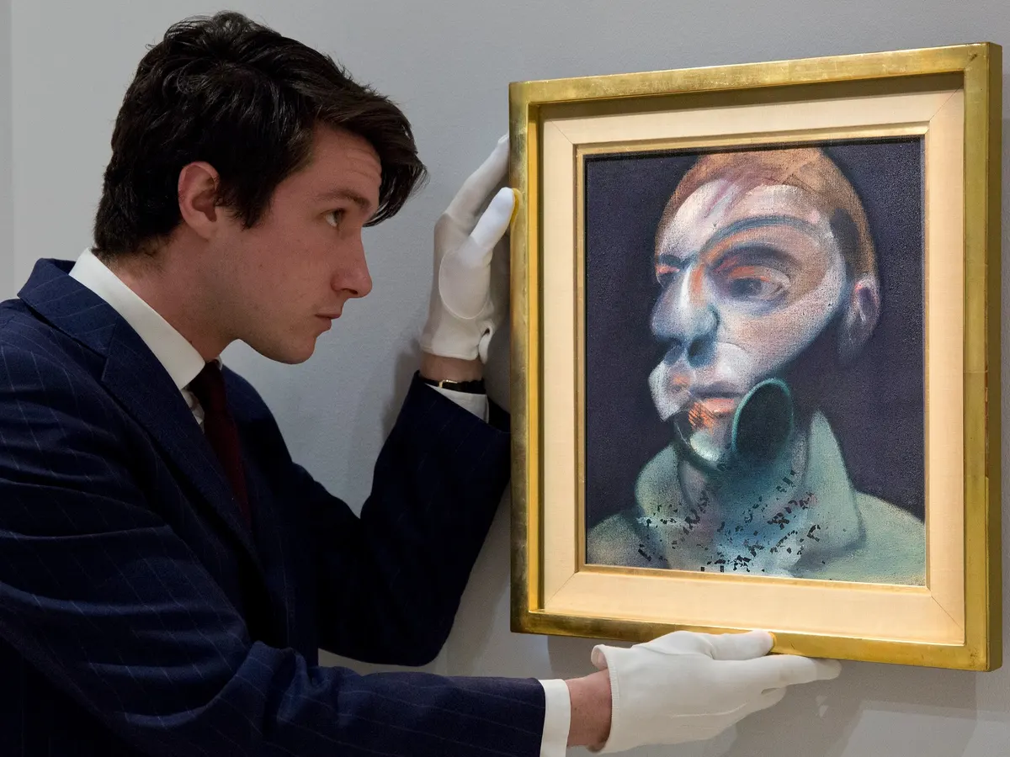
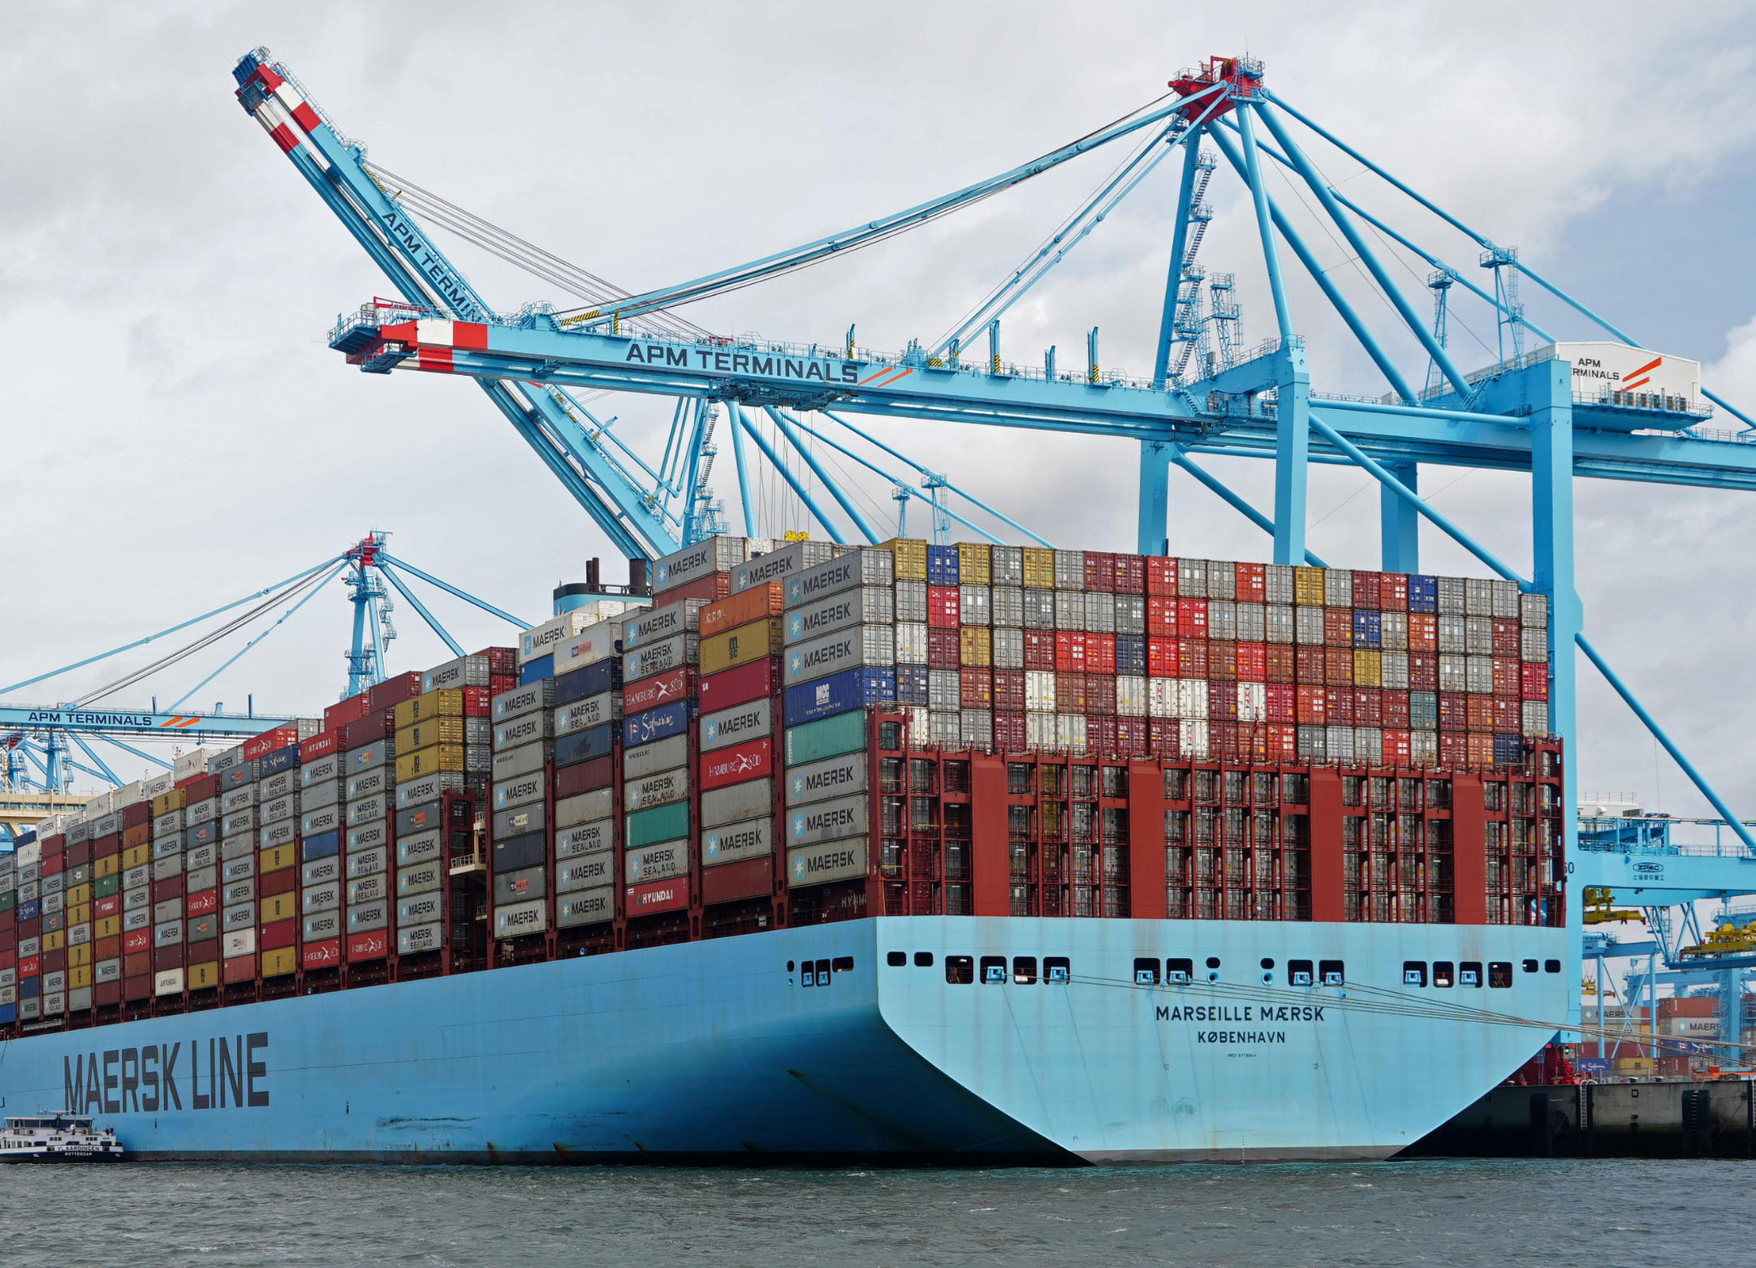
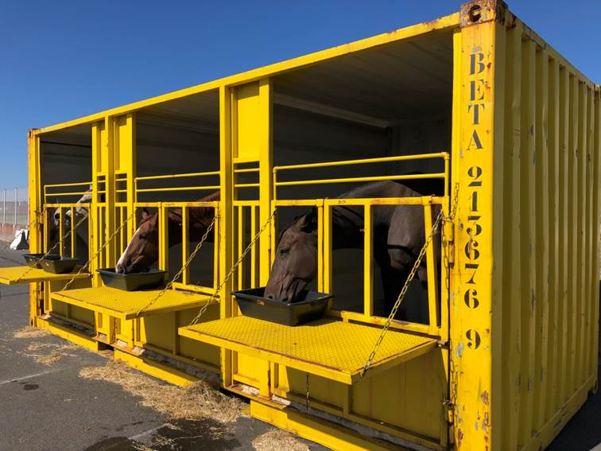
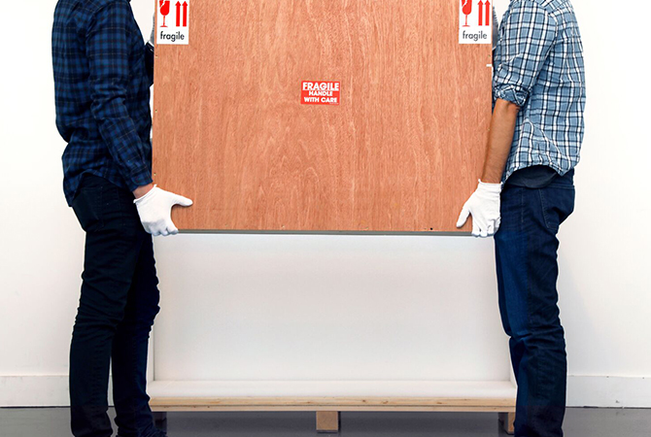
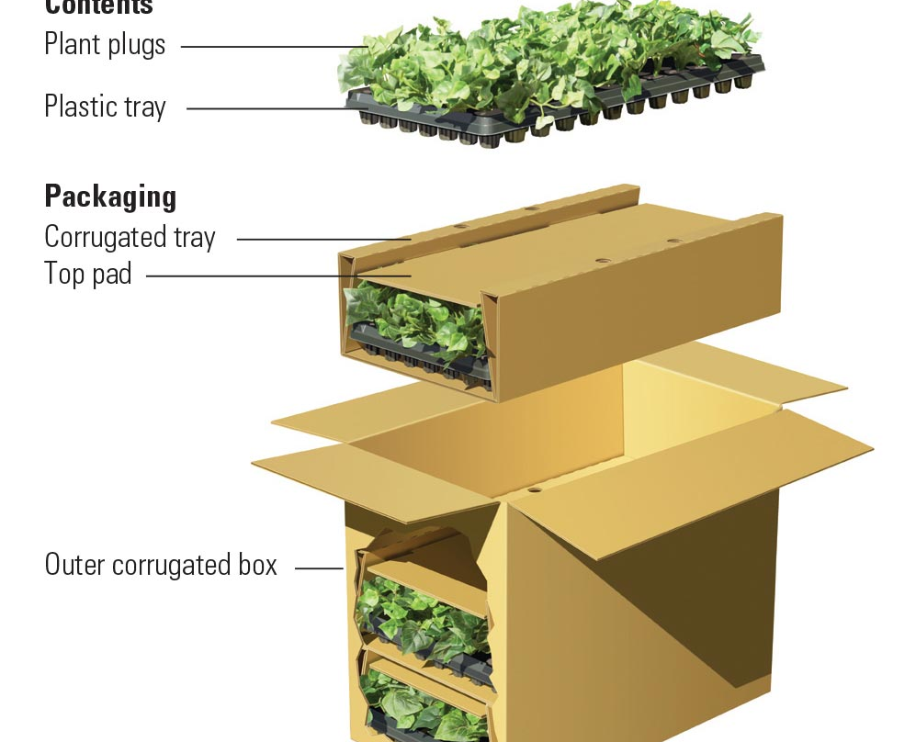
Introduction
Notes:
We aimed to help shipping companies keep track and monitor sensitive items while they are being shipped. For example shipping:
Paintings
Fresh food
Plants
Animals
Fragile objects (glass, ceramics, precise instrumentation)
Liquids (if tilted they can leak)
This way they can quickly get notified if something is not going as supposed in the process and take actions before is to late. Furthermore, if the damage is not reversible, companies can trace back where and what happened so they can find the cause or the responsible. To achieve this we use different sensors and modules to communicate with a backend that will be explained later by Erik

Slide 4


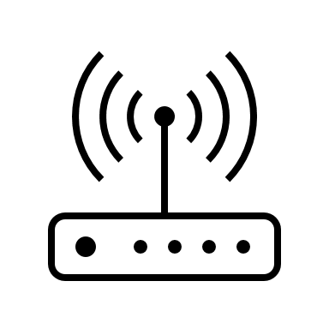


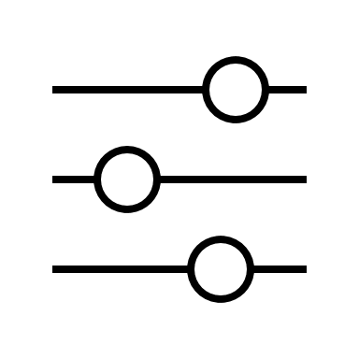




User Flow
Parcel is packaged in the warehouse
Monitor is added to the box & linked to the shipment
Type of goods (= environmental parameters) configured
Alert message sent immediately
Full log of sensor data stored locally
Notes:
In this simple flowchart we can appreciate the basic behavior of our parcel transport monitor system.
(describe the chart)

Slide 5

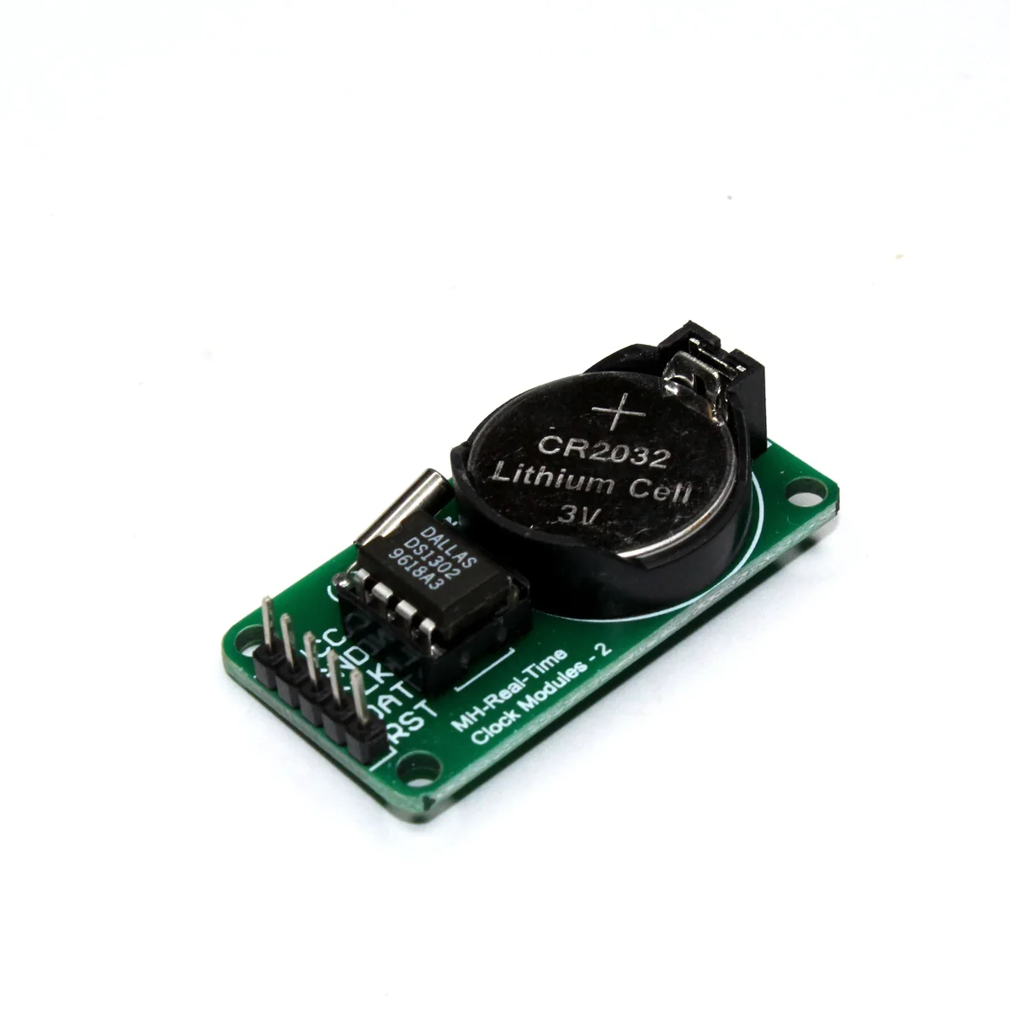
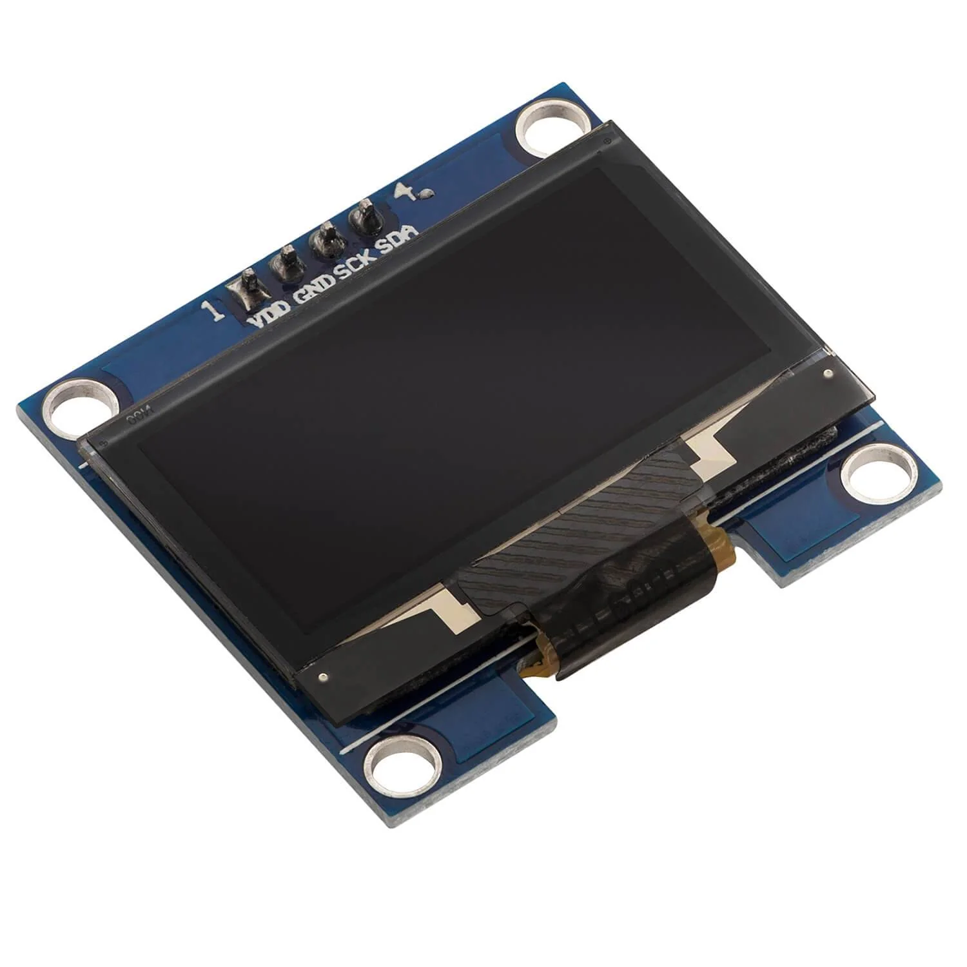
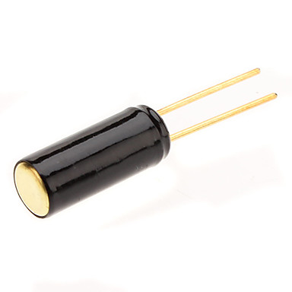


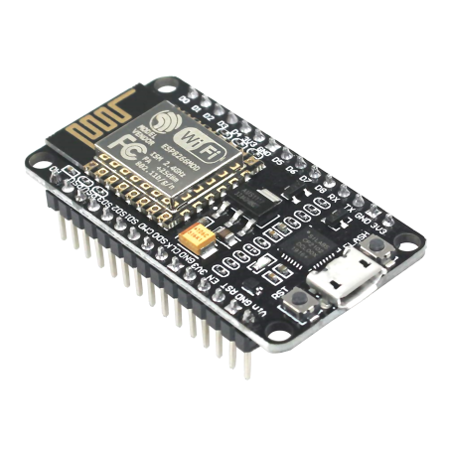

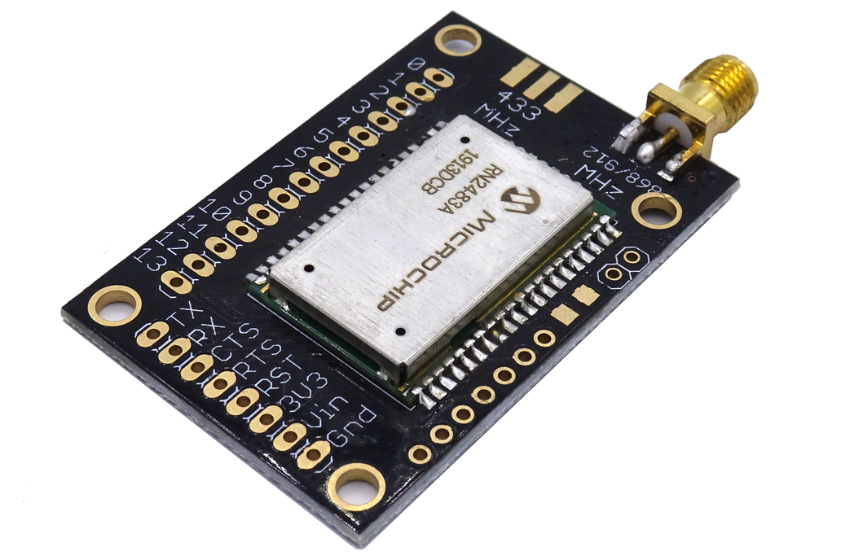
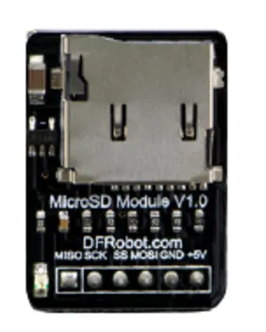
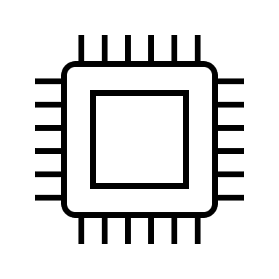


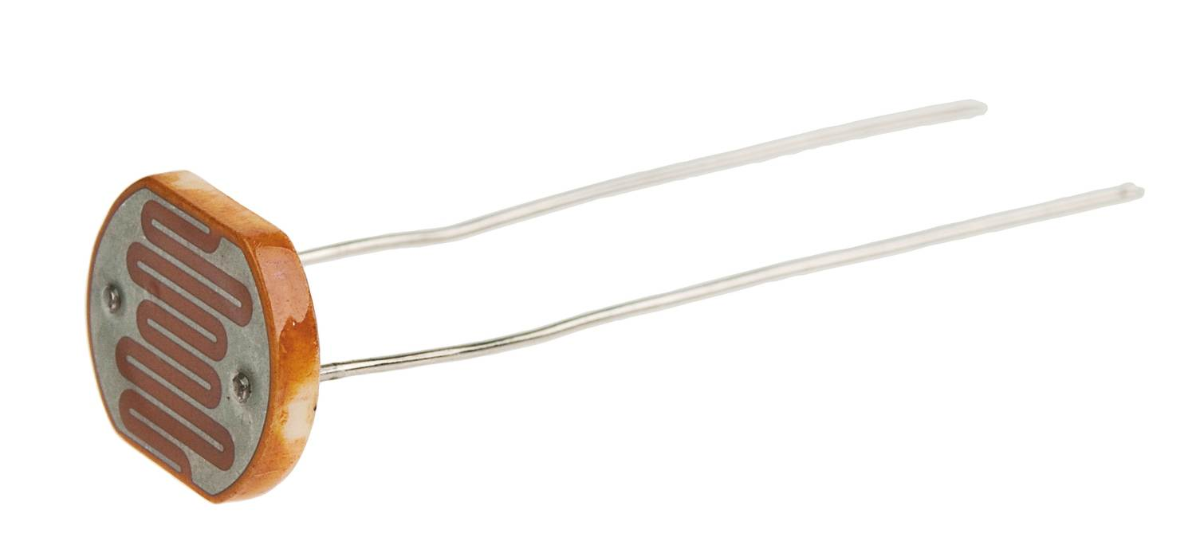
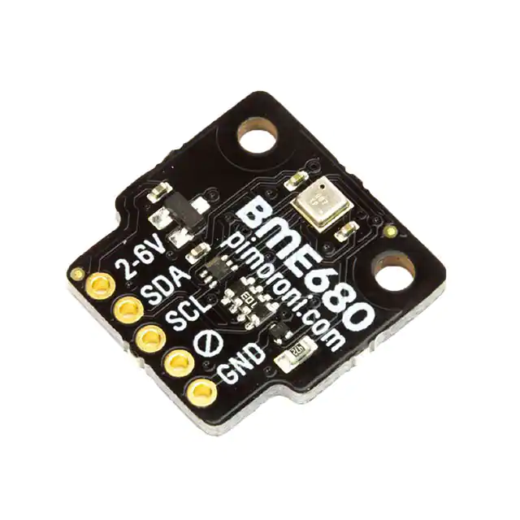



SetuSp
Notes:
Microcontroller where everything is attaches is an NodeMCU based in a ESP8266
Microchip 2483 LoRa module
RTC
Micro sd card reader
Tilt switch
Photoresistor (LDR)
Oled screen only for debugging porpuses
BME 680 temperature, humidy, C02...

Slide 6
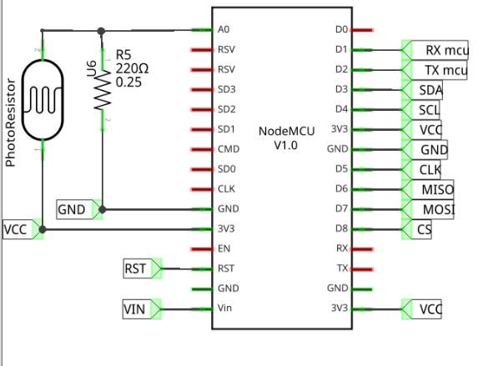
Component Connections
I²C => Moved from Default
SPI => Due to speed needed to be Primary
Uart(Hardware) => Reserved Serial for debug
Uart(Software) => I2C pins used for LoRa as well as other limitations were imposed to which pins can be used
5V, 3.3V components from different vendors added complexity to implementation
Scavenger Components on what was available and different kits had different variants

Slide 7
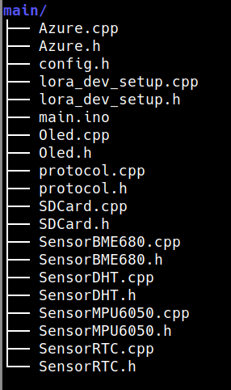
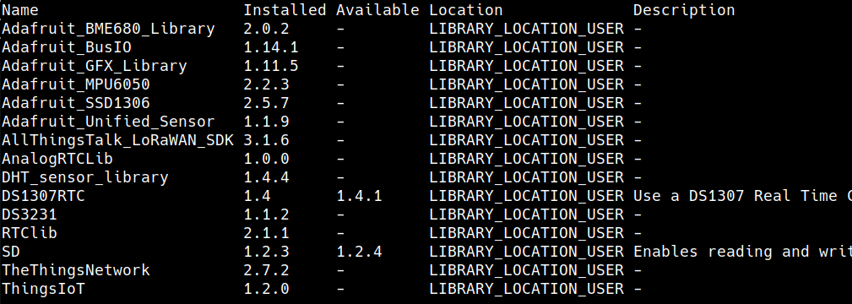
Software
Component Architecture
Sourcing - libraries
Gathered from arduino-cli and tree command

Slide 8
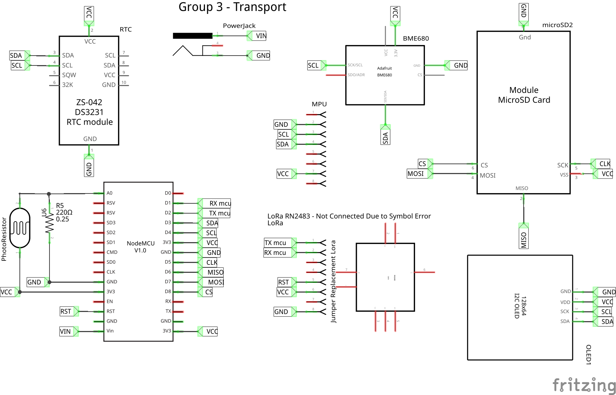
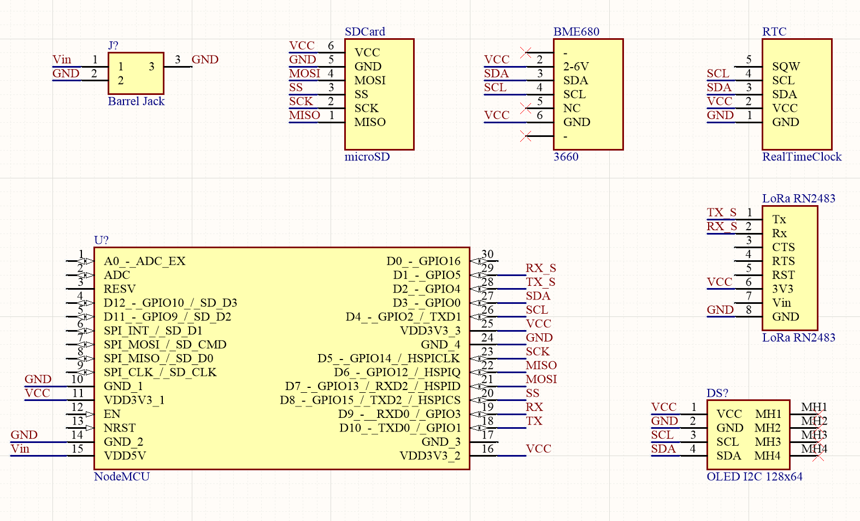
Schematic [Fritzing] & [Altium]

Slide 9
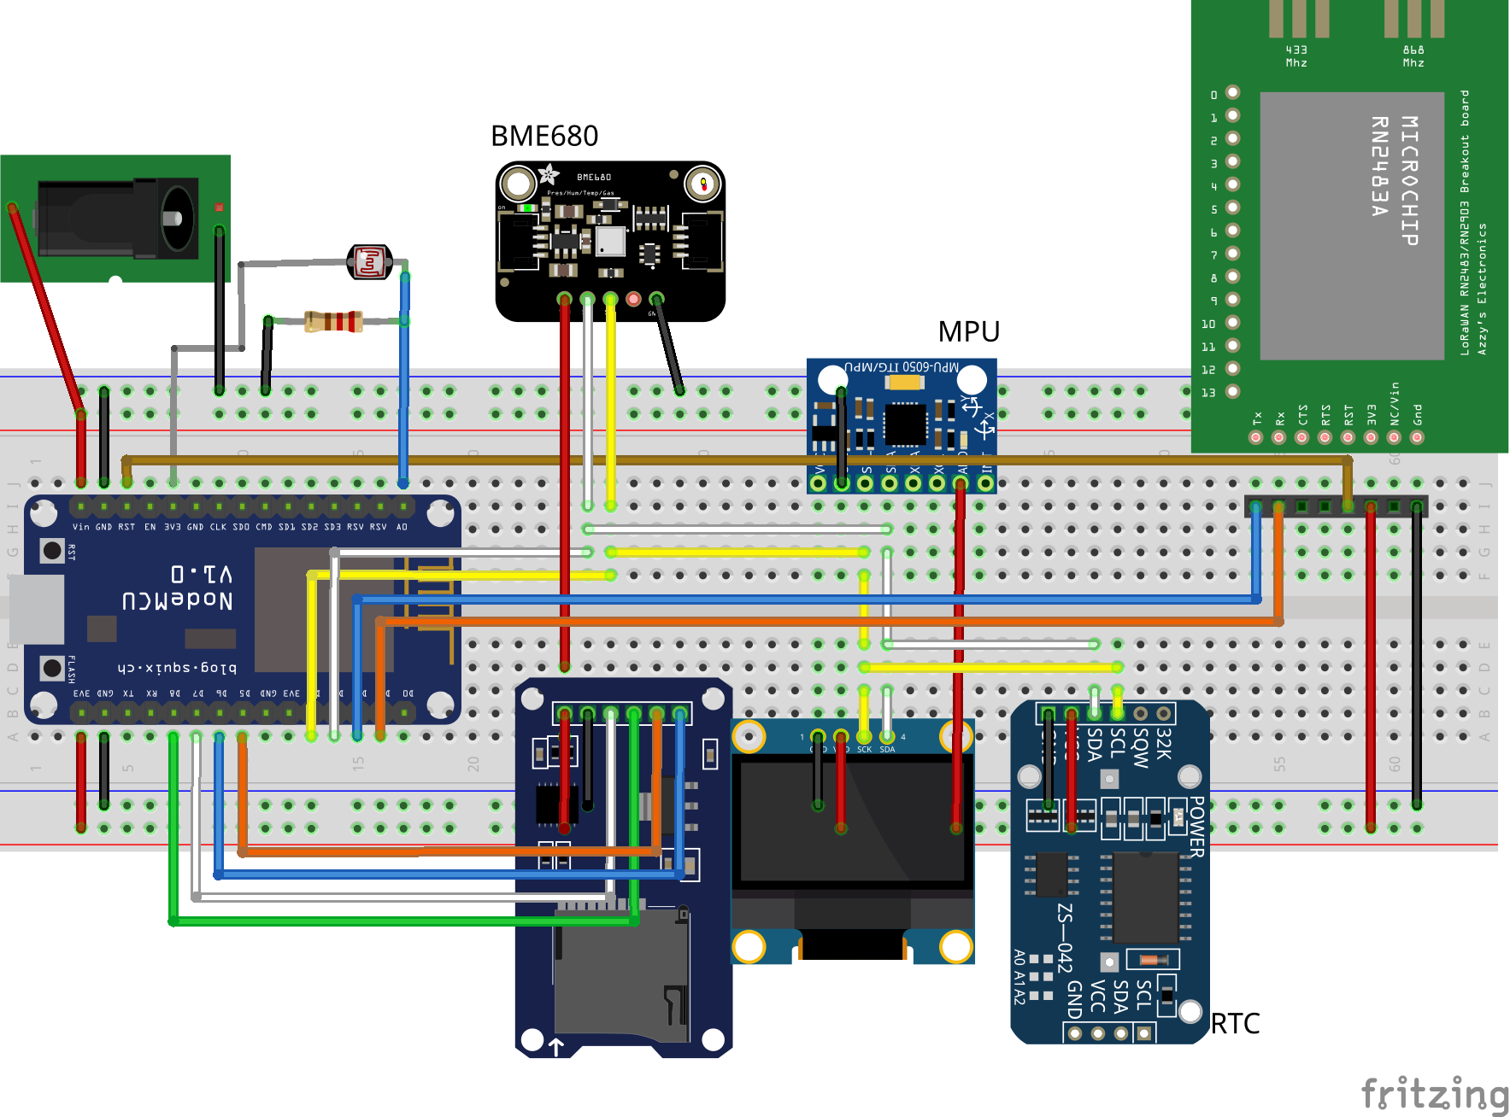
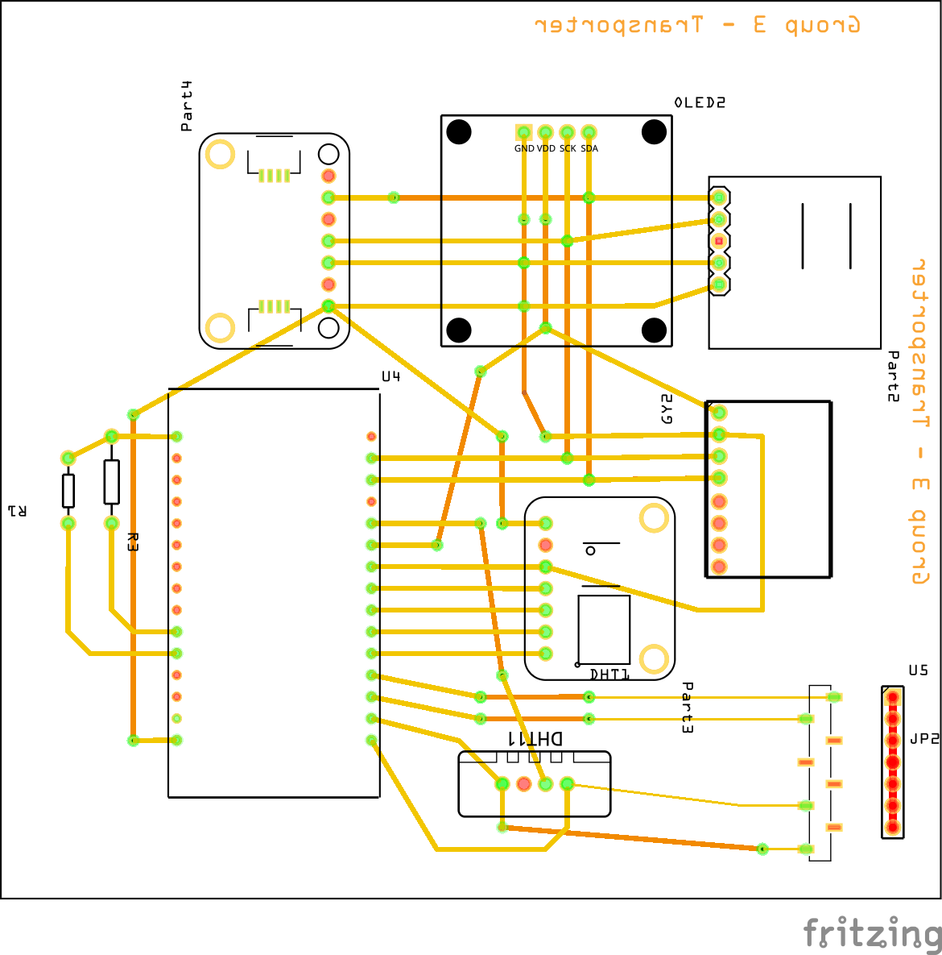
Breadboard ® + PCB [Fritzing]

Slide 10
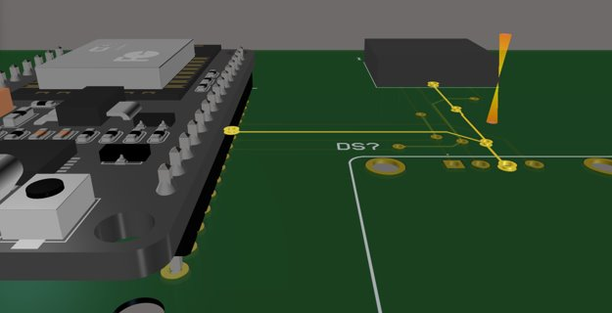
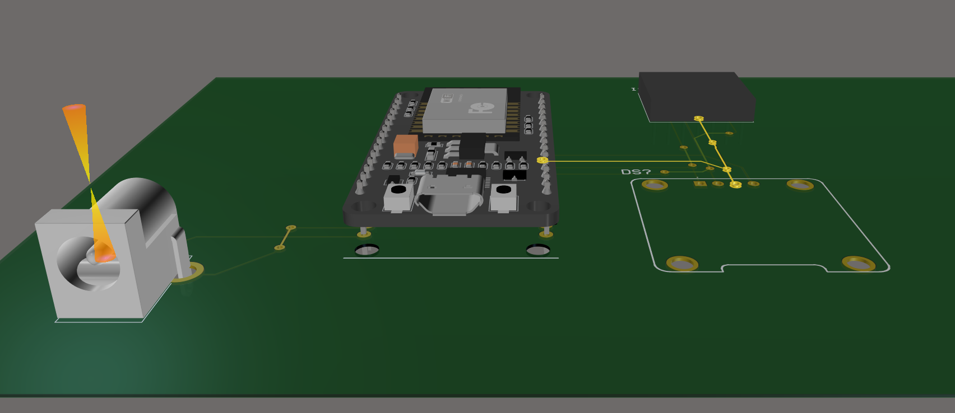
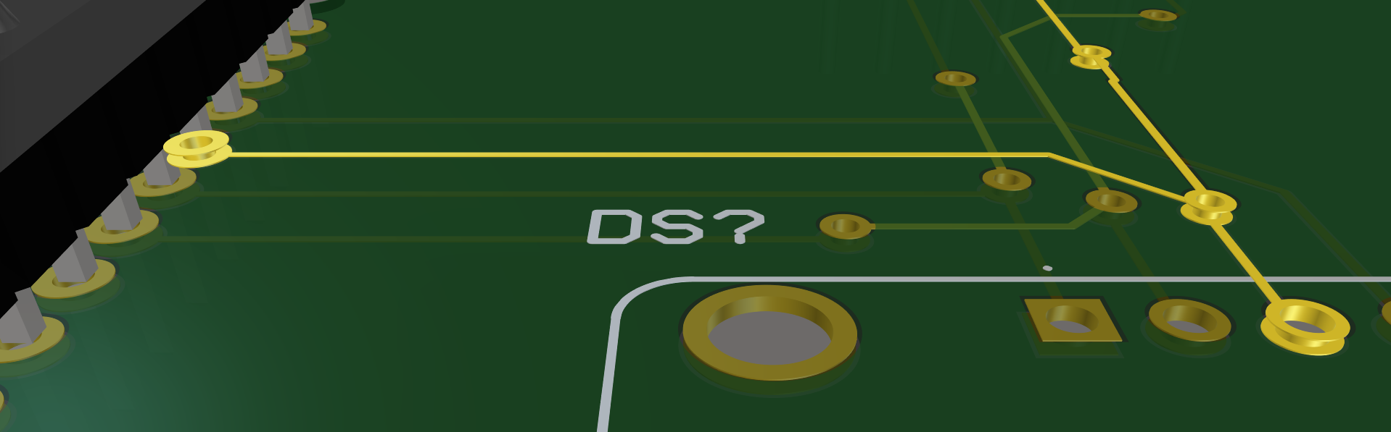
PCB Altium (missing Componentes)

Slide 11
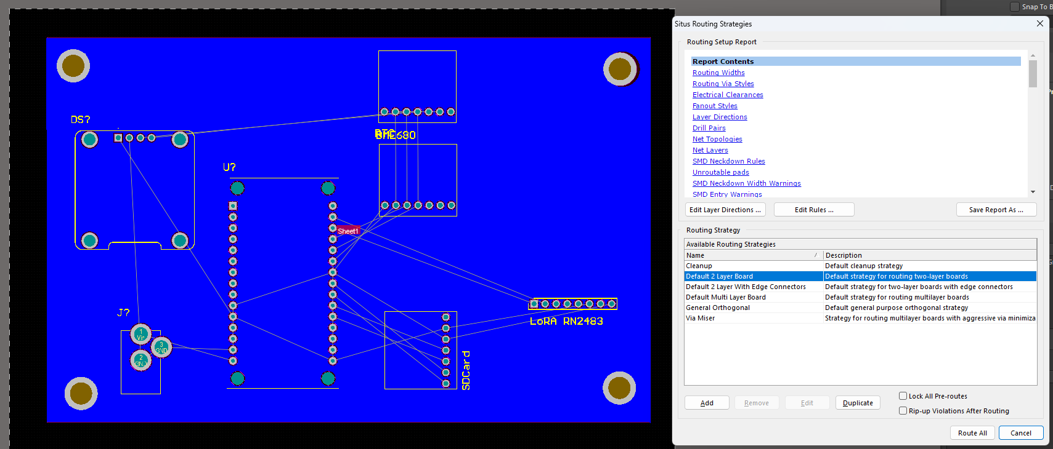
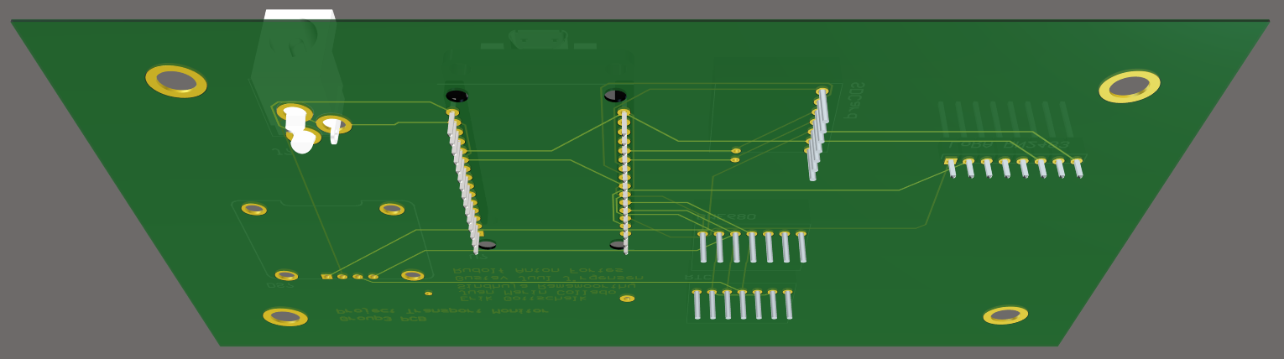
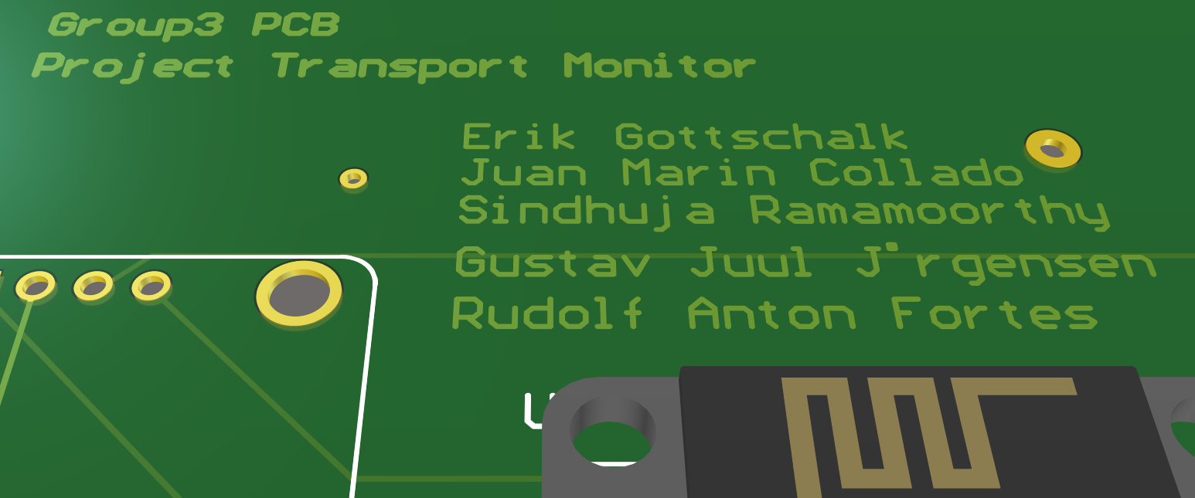
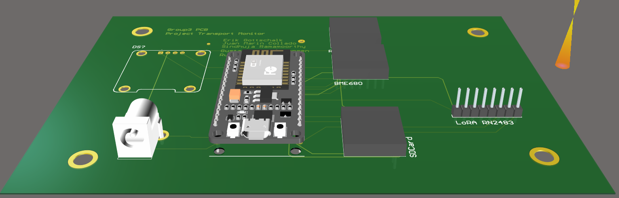
PCB Altium (Auto ROUTE)

Slide 12

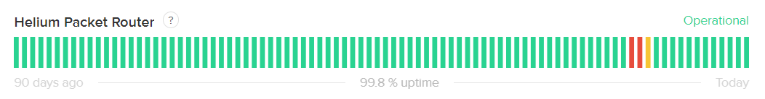

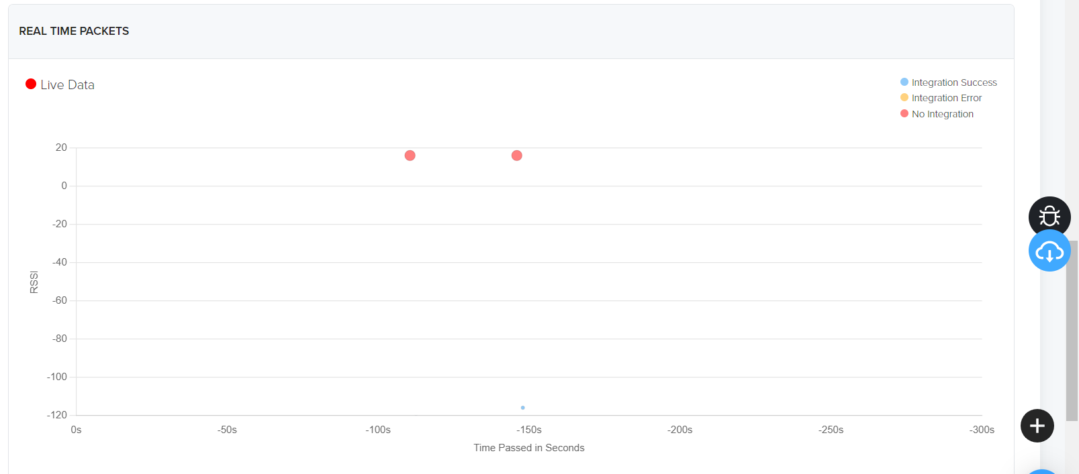

Why not LoRaWAN?
Helium migration shortage
Inconsistent coverage
Join in message received but not regular Rx
Notes:
We decided to use the LoRaWAN Helium network. It seemed a great idea as it enables a lot of possibilities and can be integrated with Azure. What we thought it was going to be easy ended up being a nightmare. Applying what we learned in lecture 5, we tried to join our module using OTAA
Old and deprecated library for the module
Helium is relatively new
Using OTAA with Cibicom works fine but with Helium, seems that it does not receive well the encryption keys or the response is not what the library expected.
Small modifications on the library where carried out unsuccessfully to try to be able to send messages. Therefore we did our own “LoRaWAN” network with a gateway to try to replicate the behaviour of Helium or we can deploy our own network in our facilities, ships, trucks, planes… (where we can cover multiple trackers and we can try to solve any possible problems with the package)

Slide 13
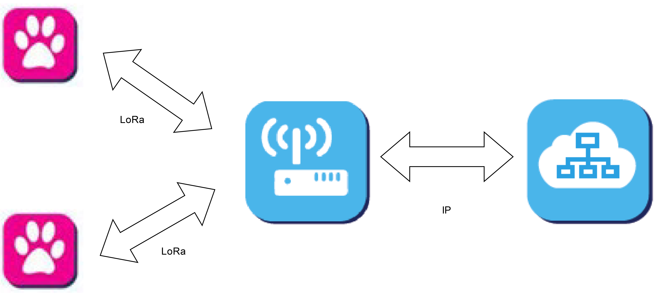
Communication technologies: LoRa

Slide 14
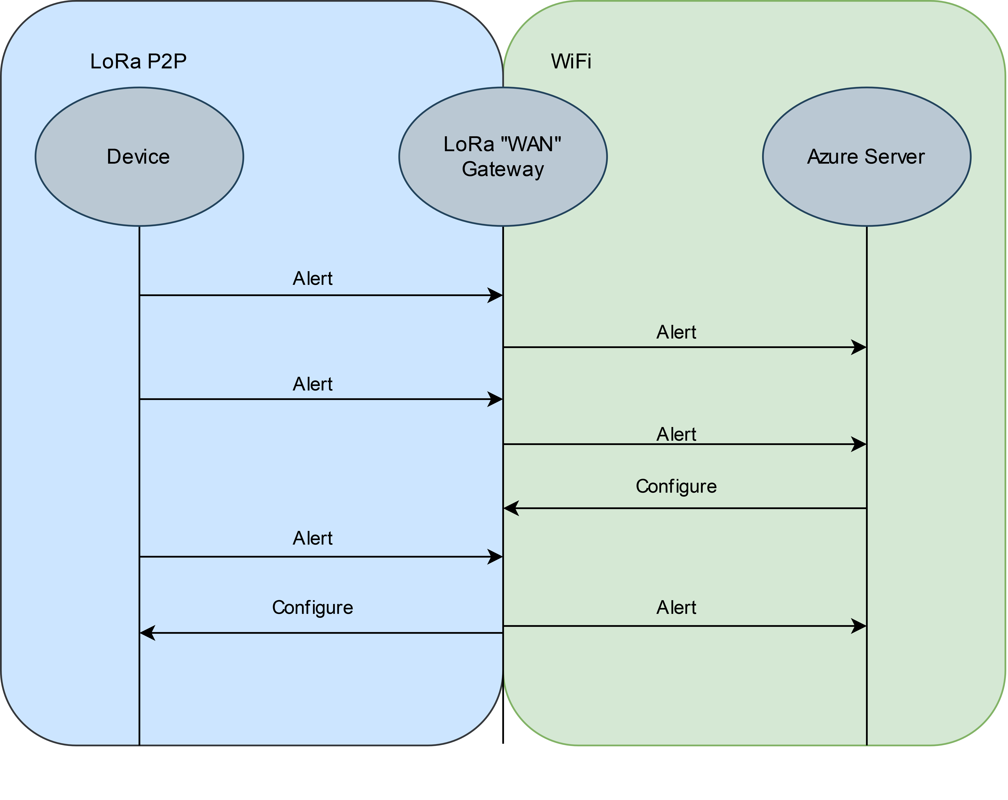
Communication technologies: LoRa & WiFi

Slide 15
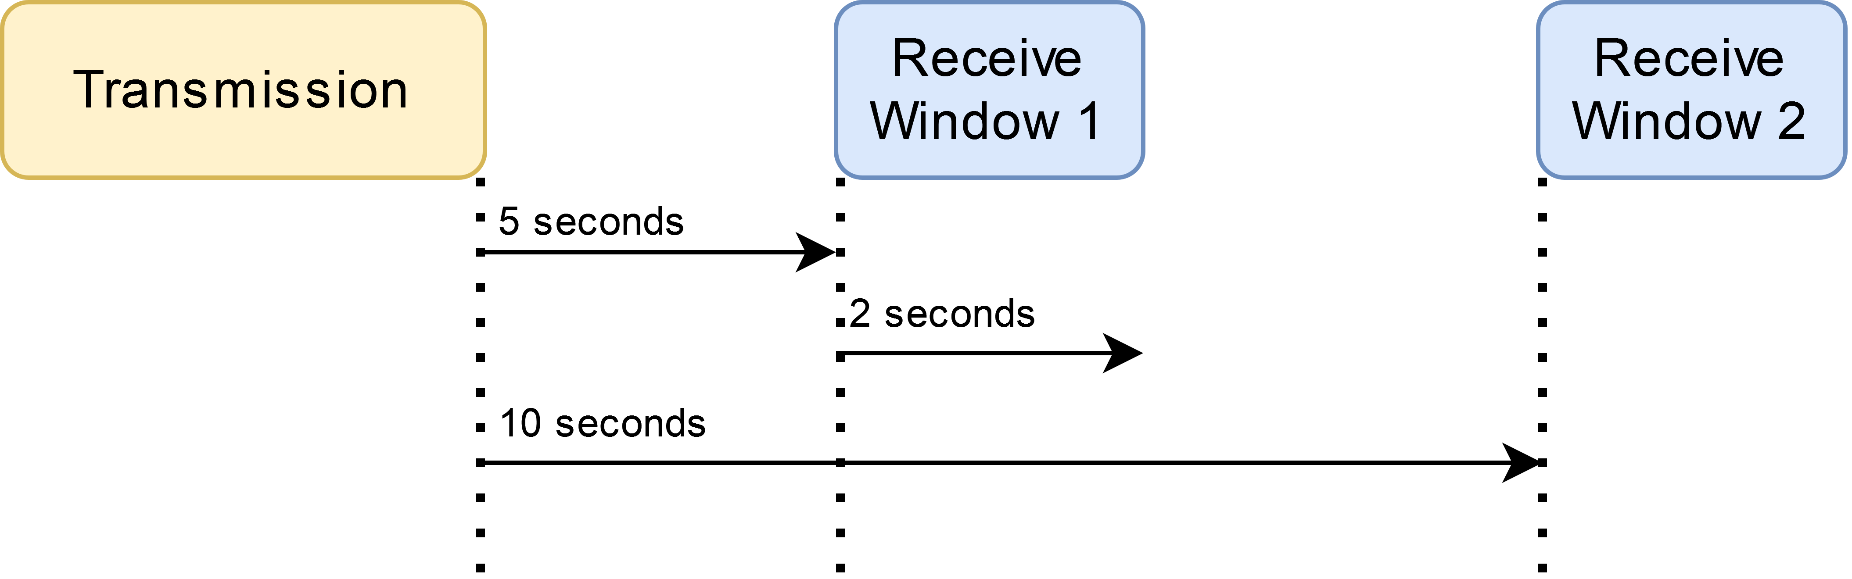
Communication Technologies: LoRa

Slide 16
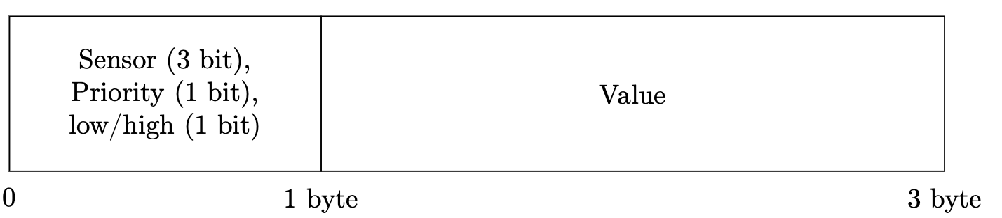
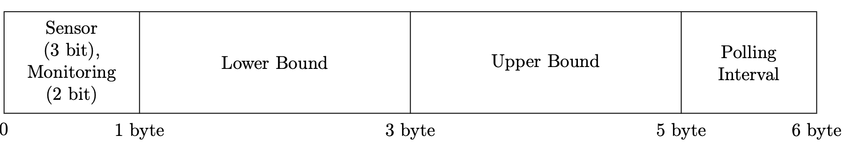
Communication Protocol
2 types of messages: Alert & Configure
Focus on shortest possible length for low-power operation
Alert:
Configure:

Slide 17
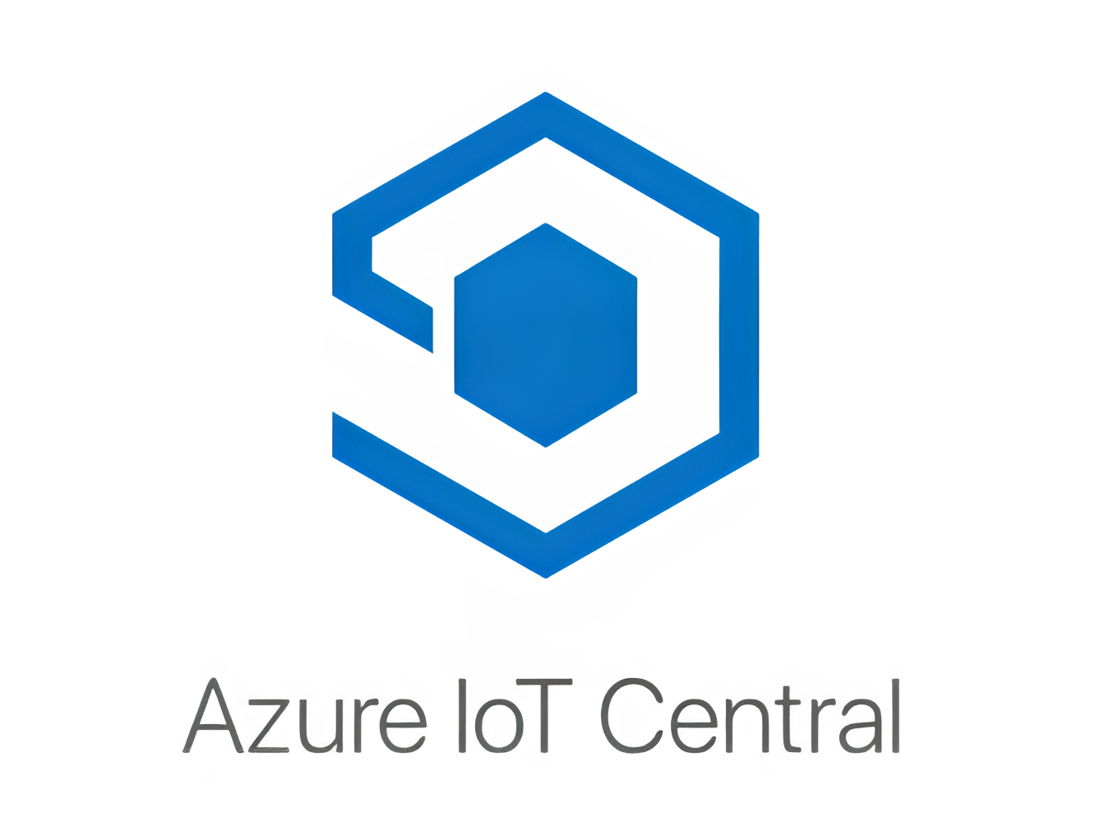
Backend
Azure
User-friendly interface
Pre-built templates
Integration with Azure services

Slide 18
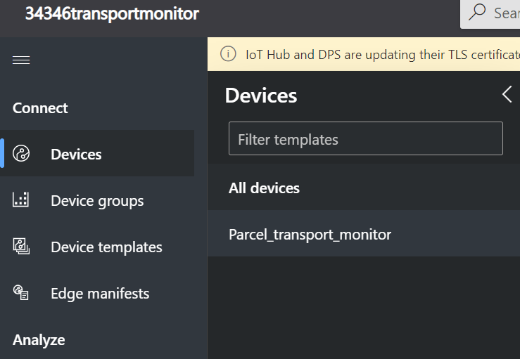
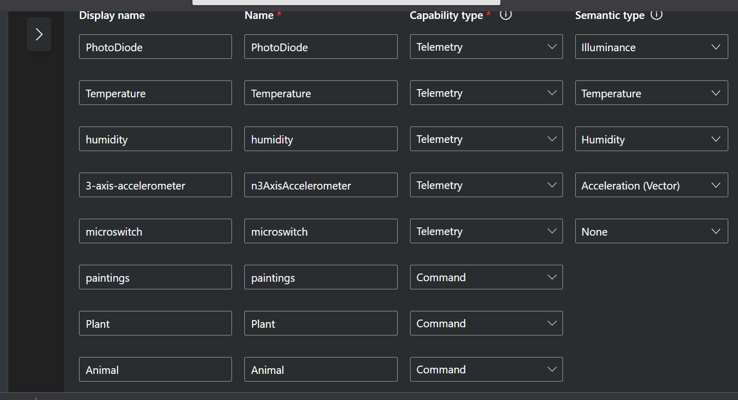
Backend: Device Template

Slide 19
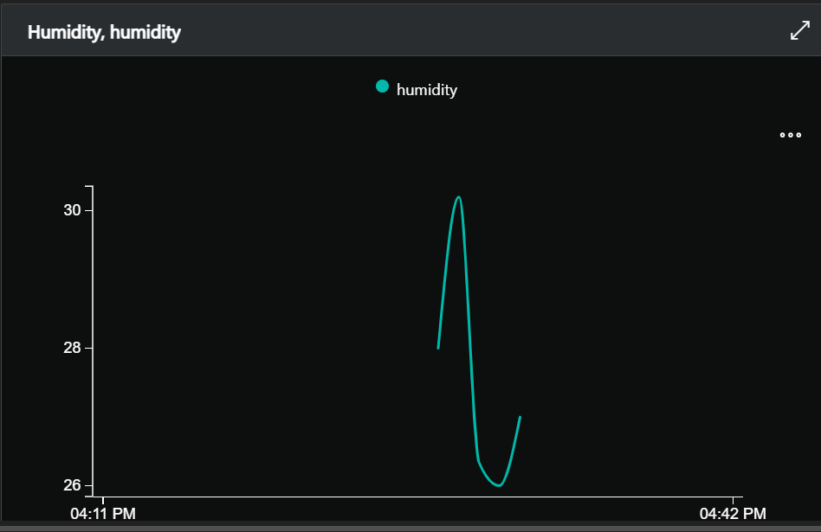
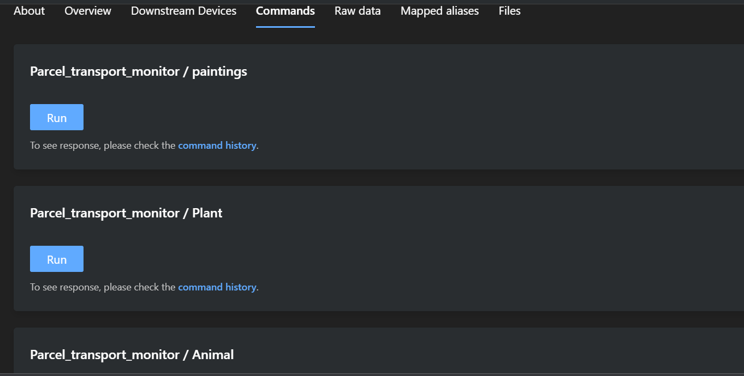
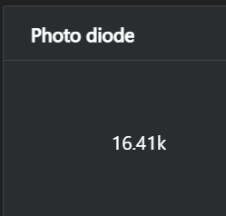
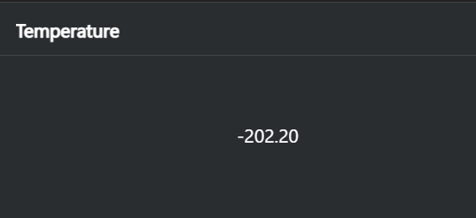

Slide 20
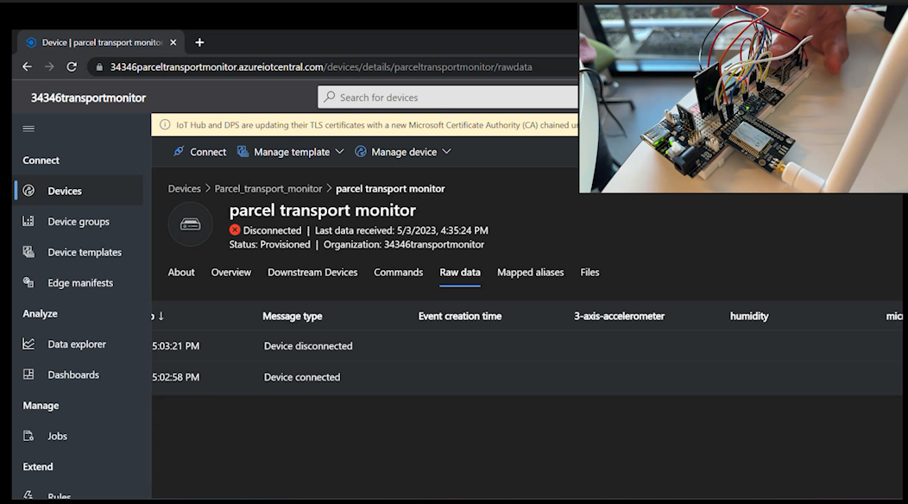
Demo
ParcelTrackerDemo.mp4

Slide 21
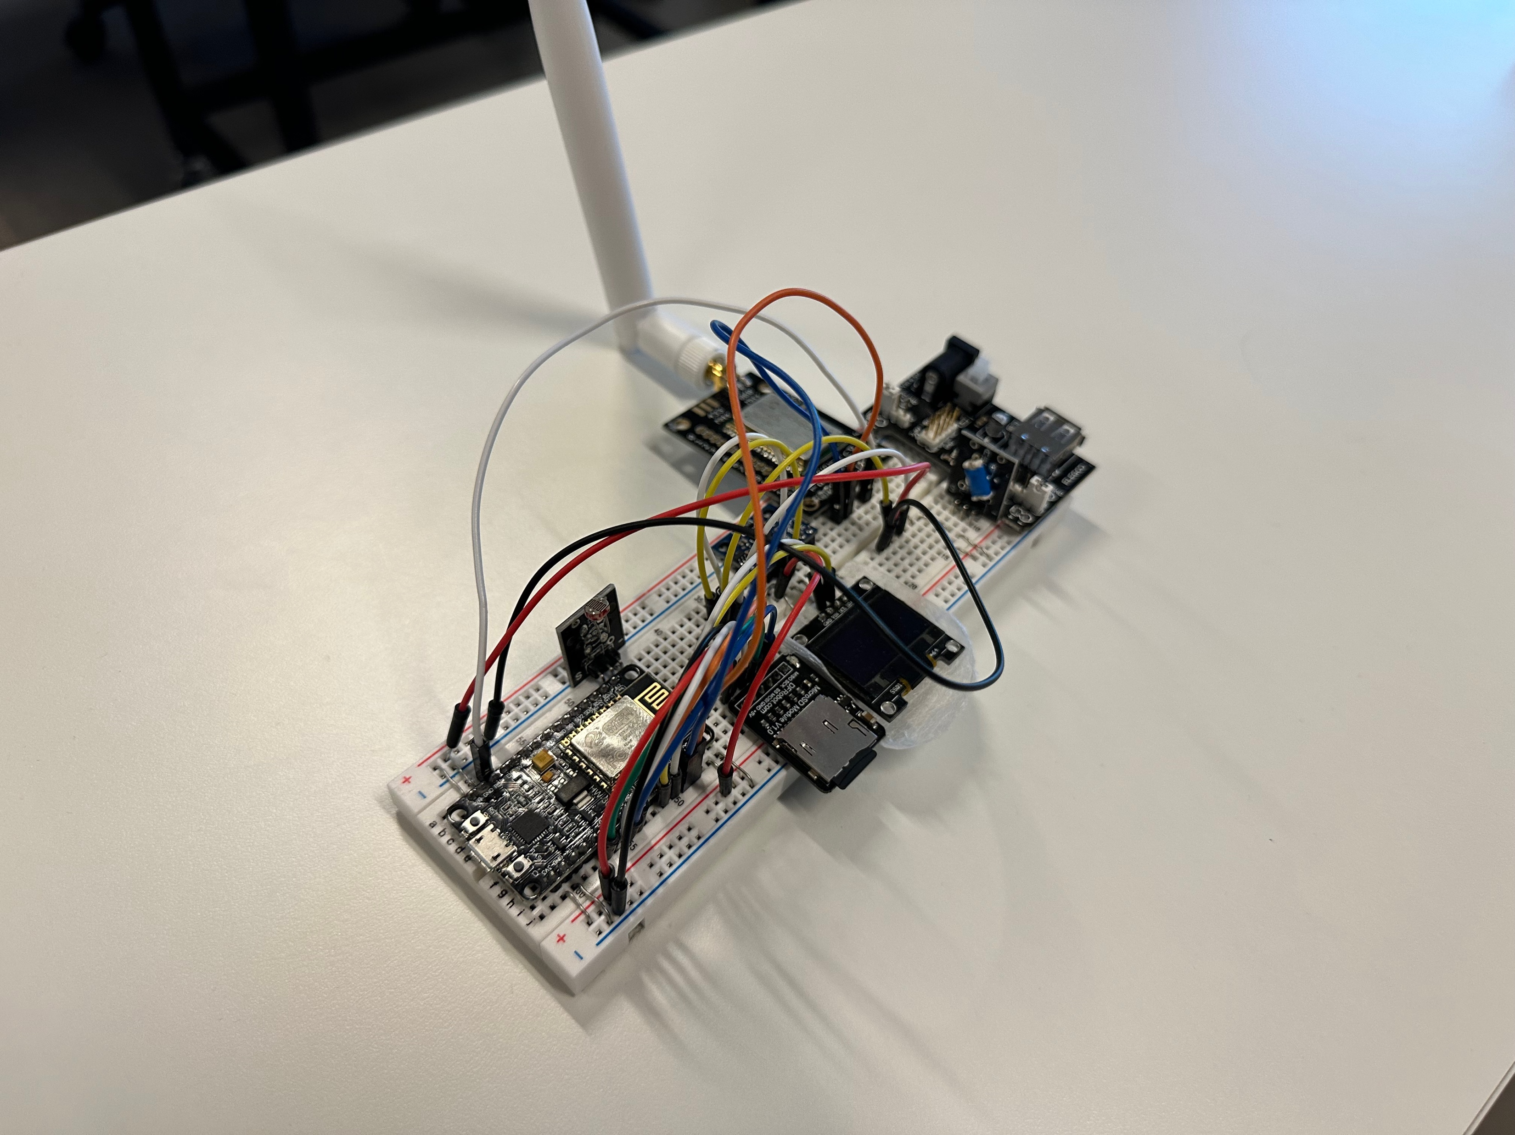
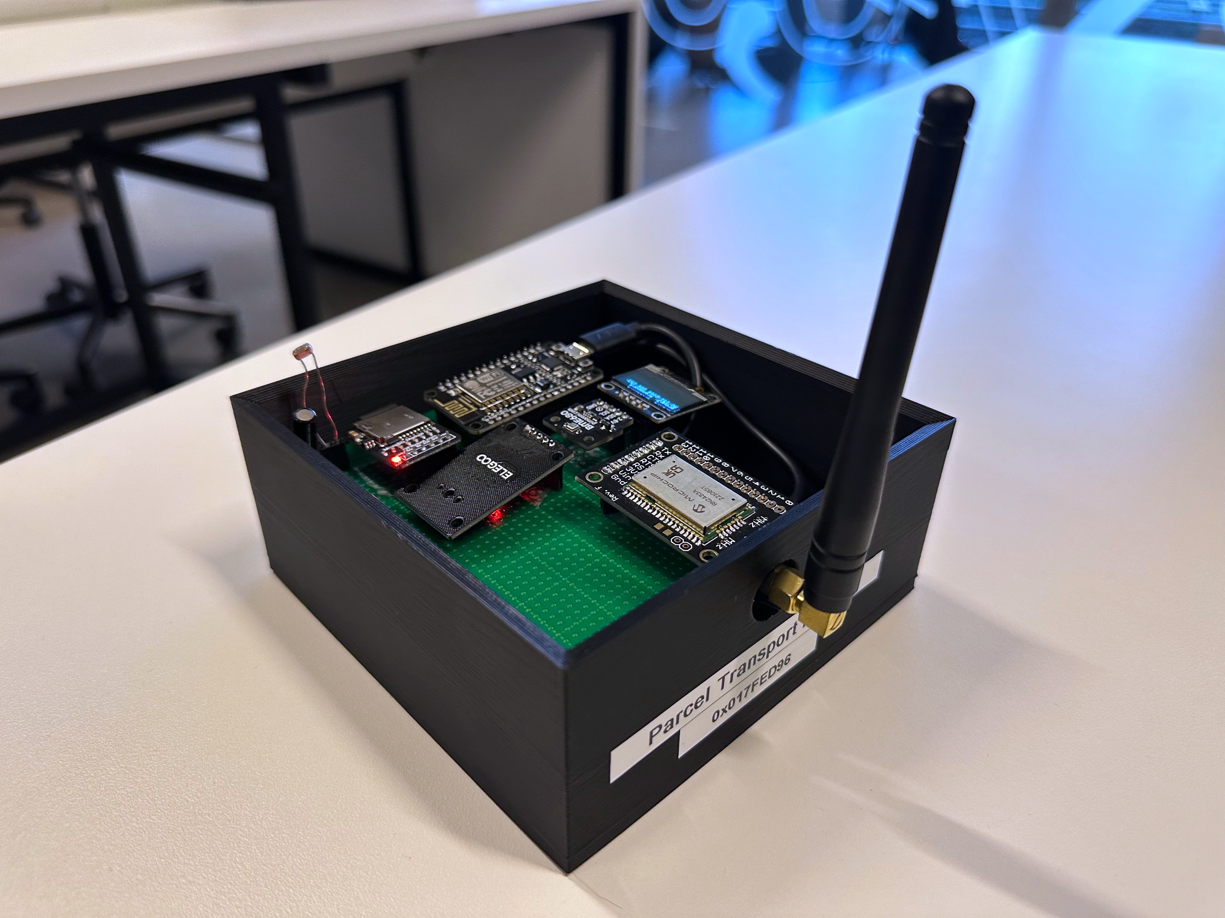
Prototypes

